Slide 1
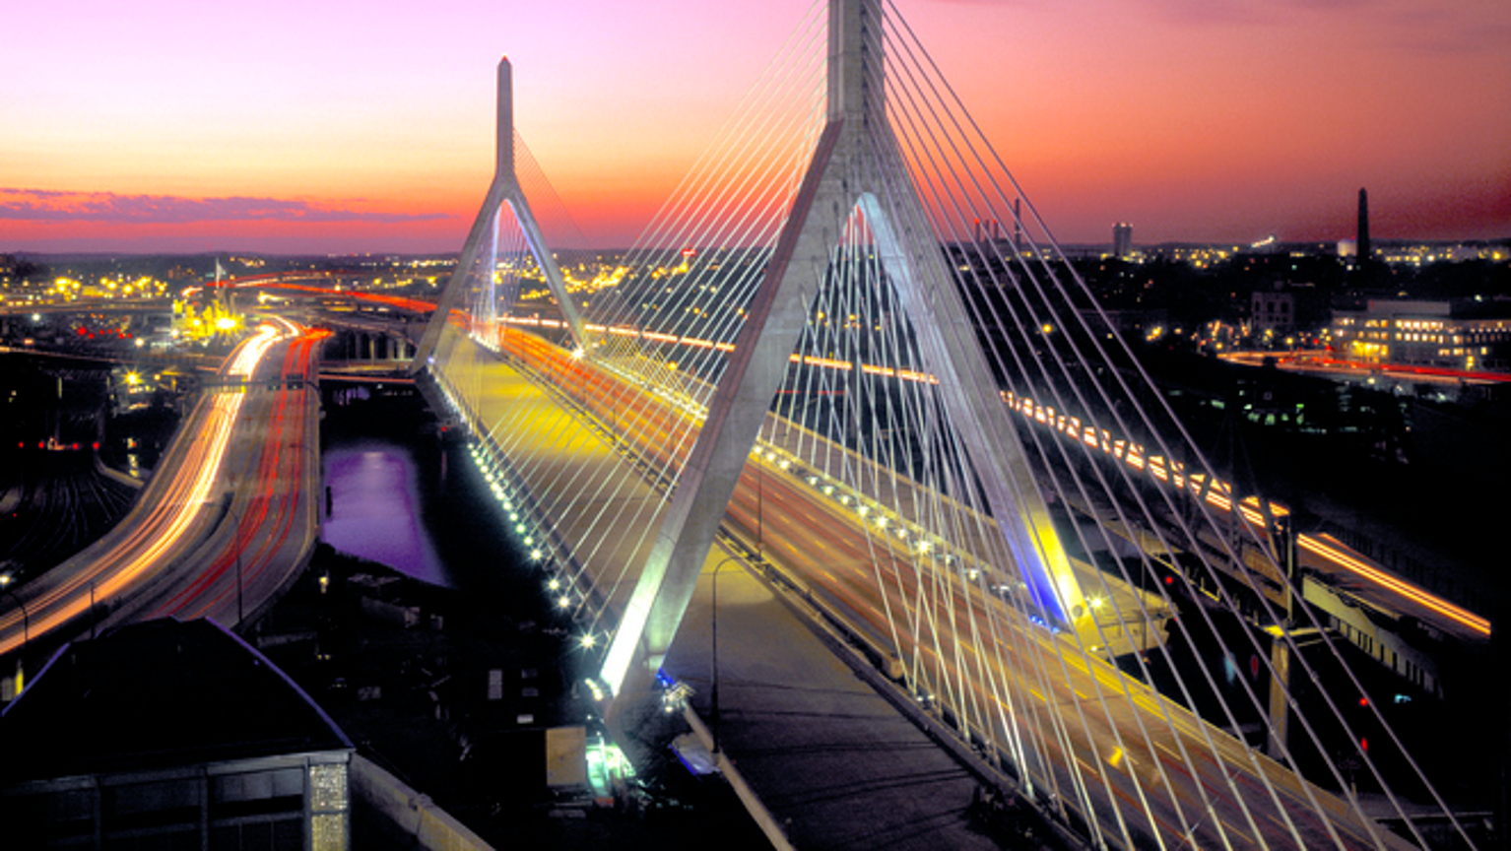
DISCOVER BOSTON
ONE PAGE WEBSITE
By: Tanisha Garner
GIT 418

Slide 2
PROJECT REQUIREMENTS
Build a one-page website that is 1280px wide (fixed)
Include valid and properly functional HTML, CSS and JavaScript (all in separate files)
Include features such jquery for tabs, the use of an API to display upcoming events, and web storage functionality
Include a slide show/ carousel of images with at least 3 images.

Slide 3

TARGET AUDIENCE
The target audience of Discover Boston are people who are looking for new destinations to travel. Their interests would be to explore historical sites, unique new England culture and a true city feel.
DEMOGRAPHICS
Ages: 20 - 60
Tourists
Avid travelers
History lovers
Sports fans
HOW WILL THIS SITE BE USEFUL TO MY AUDIENCE ?
This site will serve as a guide to all the experiences Boston has to offer. People will be able to view a little bit of history of Boston, along with top attractions, be able to create a trip plan, and view some aesthetically pleasing photos around the city.

Slide 4
BACKGROUND
In this project my main goal was to create a one-page website for an idea of my own choosing. I chose to create a digital interactive pamphlet about the city of Boston because it is my home. I work in the heart of the city as a server and host many tourists at my tables daily. I thought it would be a fun project to create to answer the many questions if get about Boston during those interactions.
THE PROCESS
I first started by creating some wireframes drawn by hand to get a visual representation of the layout of each section and their elements. I then used Canva to create a logo and brand feel. I thought about all the features I needed to implement and how they would relate to my project. As I drew out each section from beginning to completion, I thought about how to make each section fit in a visually appealing, yet simple way.

Slide 5

BRAND
Discover – History, Culture, Sports, Fun, Views, BOSTON. This slogan is meant to highlight the variety of things there is to discover/explore in Boston.
Founded in 1630, Boston was established and became a famously known for the Boston tea party in which colonists dumped tea into the harbor in protest of the tea act in 1773.
This website encompasses the modernize feel of Boston. We’ve come a long way 1773 but we hold a multitude of historic sites that many come to experience. The goal was highlight some of Boston’s past while also giving way to the modern day feel of Boston and its surrounding community.

Slide 6
CONTENT
While researching for content about the city of Boston, I gathered many amazing images of historical sites, sports themes, recognizable locations, and popular tourist spots.
I also researched for APIs and used Ticket Master as where I would pull my data from. Along with deciding to utilizing slick for a simple slideshow widget/plugin.

Slide 7
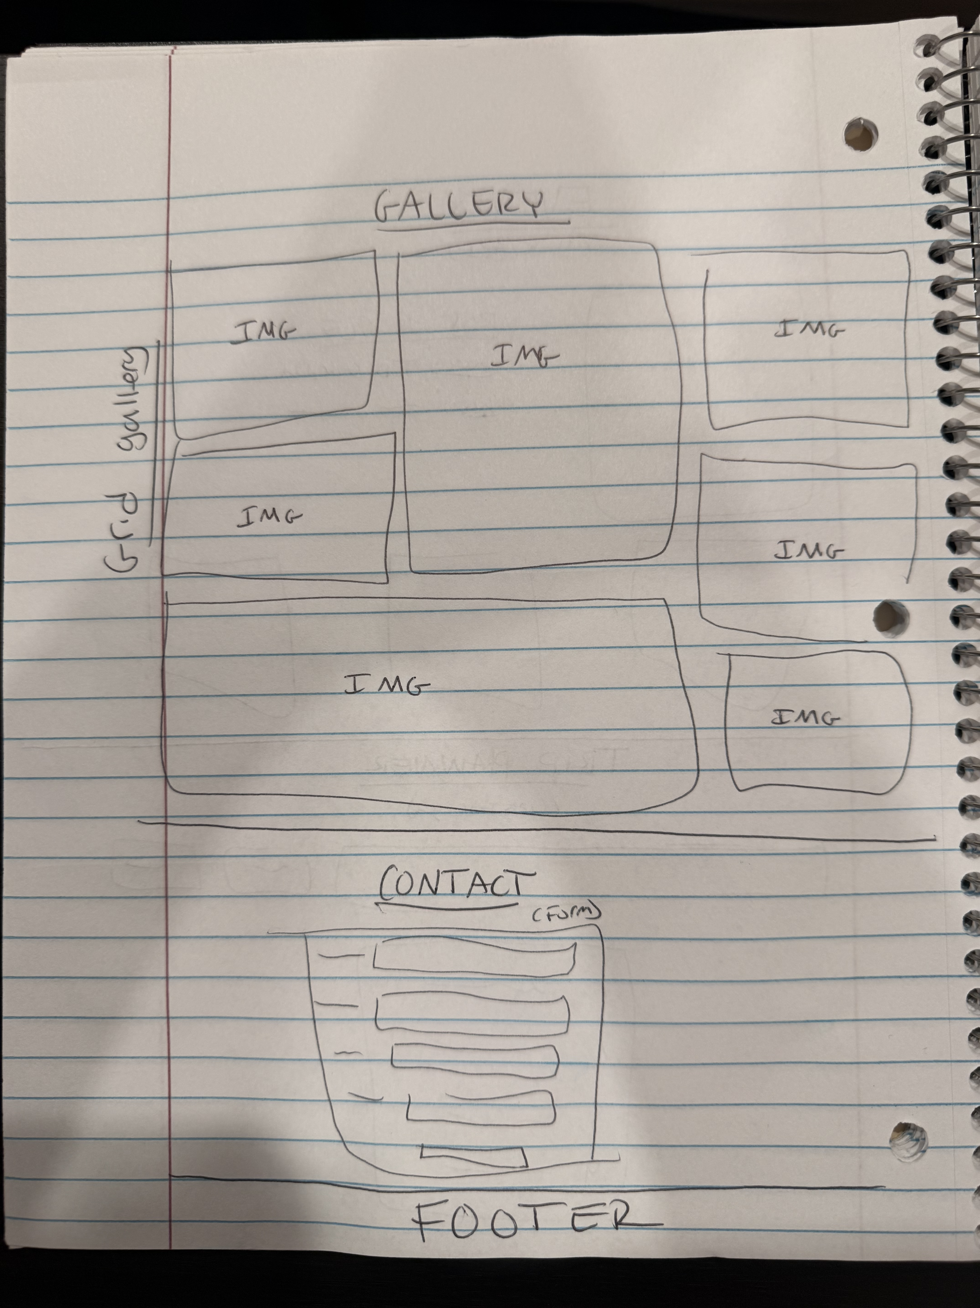
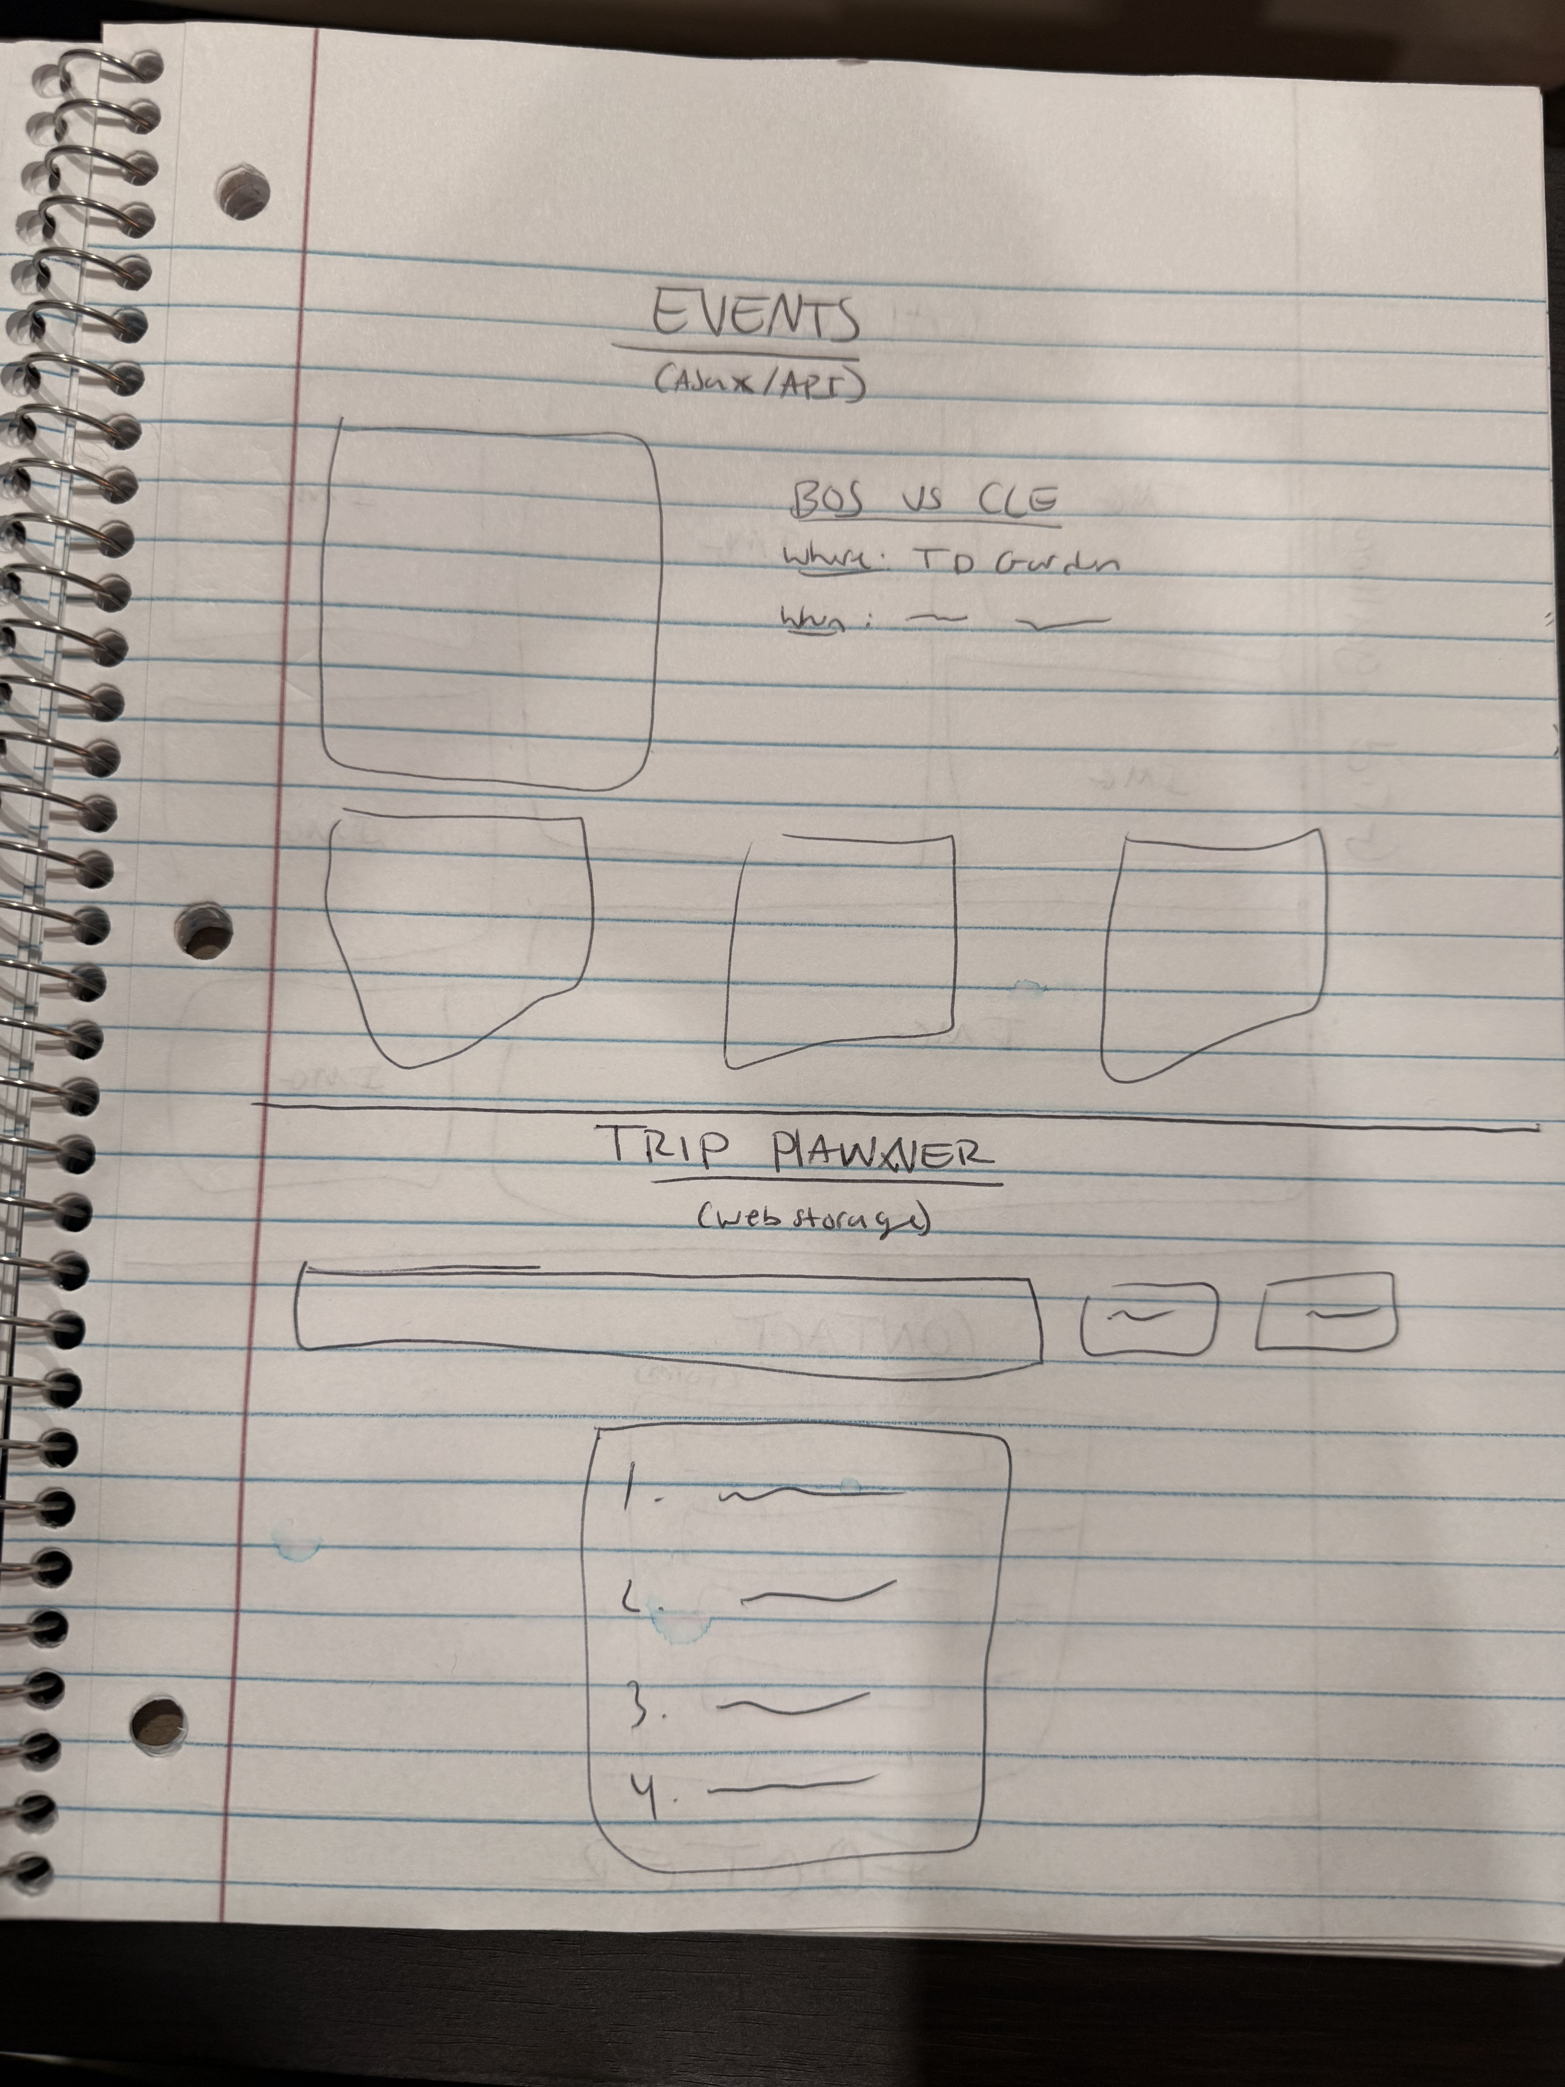
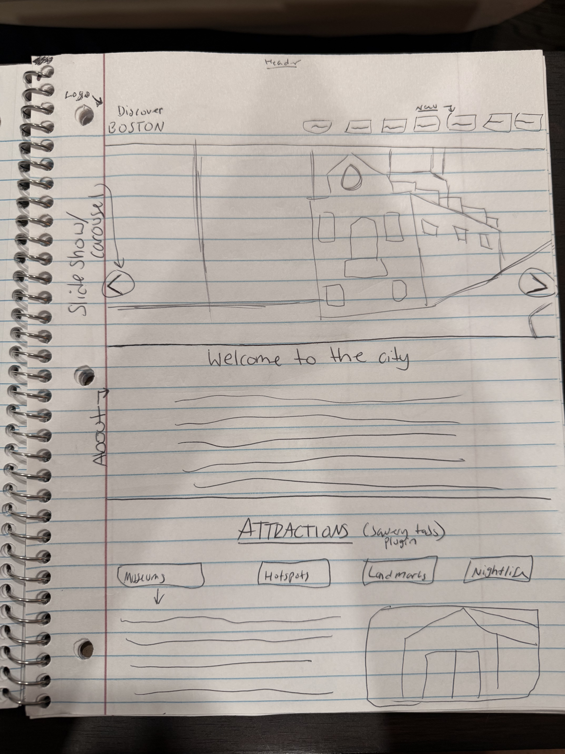
WIREFRAMES

Slide 8

HTML
The HTML I’ve written is based on the wireframe that I created first. It proved to be a useful guide for simplifying the structure of my page with visual representations.
I made sure to draw out lines where I knew I wanted sections to start and end. I used sections and divs to make it easy to later code for CSS styling of the page. While coding each section of my HTML, I made sure to give the elements proper Ids and classes.

Slide 9

CSS
Using the Ids and Classes linked to elements in my HTML file; I was able to target certain elements and style them based on the theme of the brand.

Slide 10
JAVASCRIPT
After completing my HTML and CSS files for the layout and styling of the website, I now had to include JavaScript to implement features in the product requirements. There were 4 main requirements for this project:
The first feature I implemented in JavaScript was using the slick theme plugin to create a carousel of images right below the header. I included images that encompass the vibe of Boston. Implementing this by first downloading the slick.min.js file along with its CSS files for adjustments to the plugin. This allowed me to include it my projects JS file to create the slide show.
The second feature I implemented was using tabs via jQuery to create tabs that held different category cards. Each card held information related to that tab topic. I made sure to download the proper files from jQueryui.com to access the tabs/accordion widget. I then wrote a function to access those tabs, along with minimally styling the tabs to my liking.
The third feature I implemented was using an API through Ticket Master to load in different types of events via categories. I read through their documentation to figure out how to access their different types of data to pull from. I After choosing my topics, I looped through each event to display it in a card.
The fourth feature I implemented using web storage to take input from a user and display it to a list. The user would be asked to enter their trip plans and then it would add/display it to an ordered list on the page. The user will be able to return to the page and still see the list saved due to storing list items in localStorage. They can also clear the list which also removed key/value pairs from localStorage.

Slide 11
REFLECTION
Overall this project was very fun for me and allowed me the opportunity to discover more of my hometown. If I had more time to complete this project, I would move the “Discover – History, Fun, Boston,” etc. on to the slide show and change discover to explore. I would also have included more attractions, landmarks and hotspots.
This project has allowed me to further deepen my knowledge of how HTML, CSS and JavaScript work together as a whole, while also learning how to use jQuery, widget/plug-ins and APIs from external sources.
In the future I can improve on how to better connect between the languages and improve on my knowledge of JavaScript to further condense and clean up my code.
Although I have come a long well with my understanding of HTML, CSS and JavaScript, in the future I think I can better improve in organizing my code. I’m going to work on better understanding how to write my JavaScript in order and why certain functions need to go before others. After much trial and error, I now see how important order is. My goal is to better understand and deepen my knowledge to create better, more concise code and more aesthetically pleasing websites.

